Slide 1




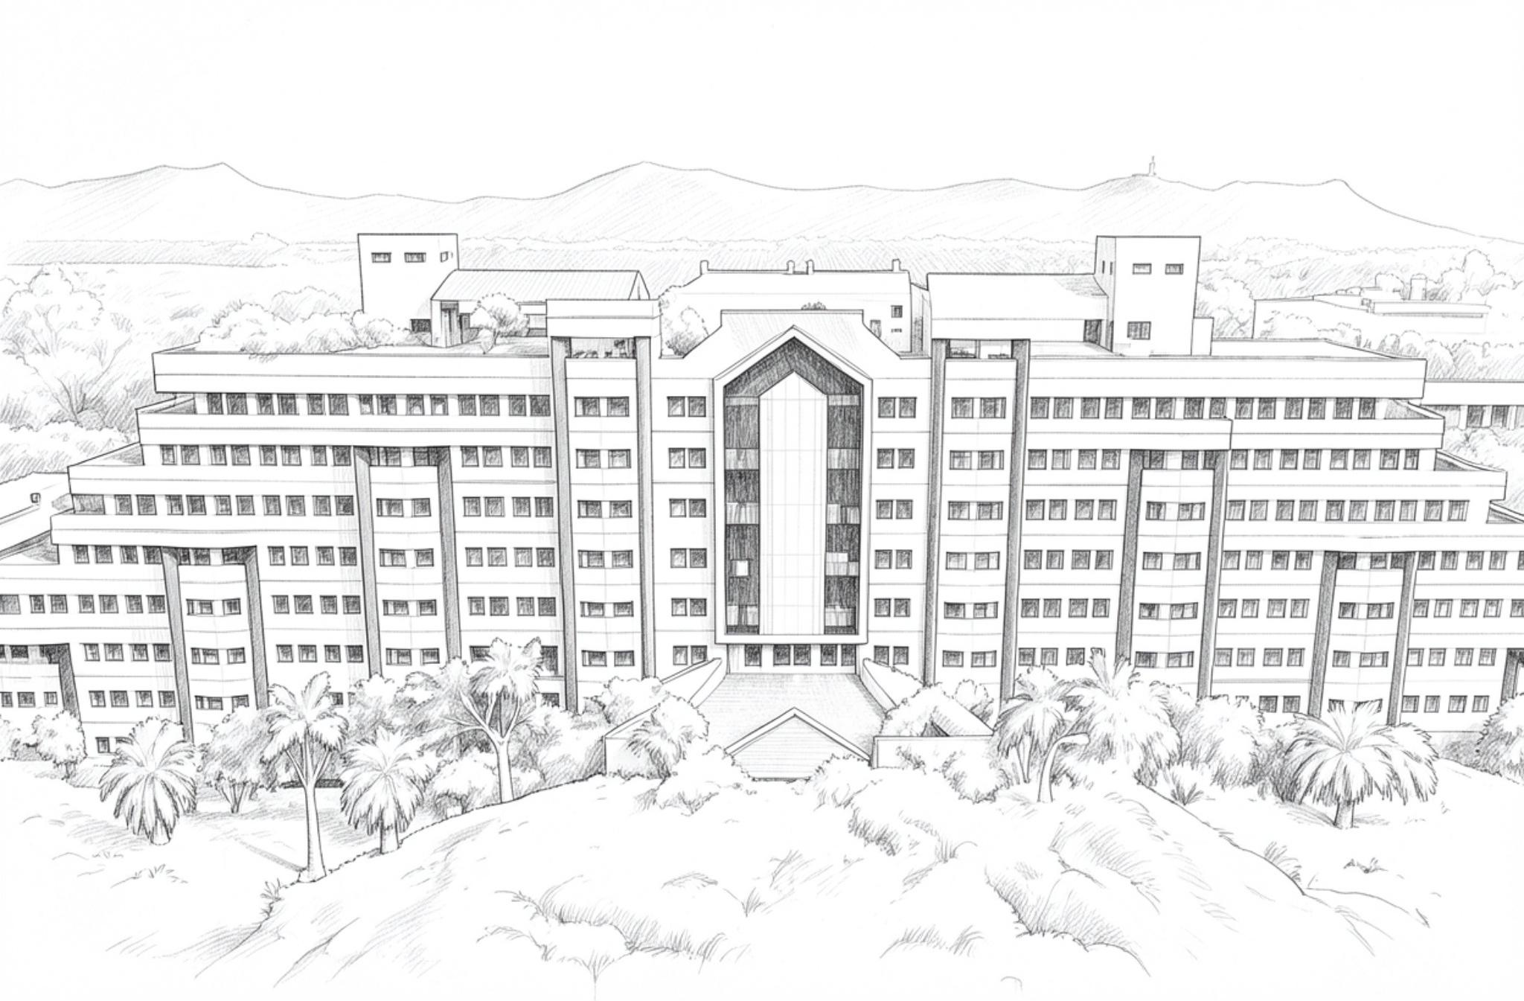

INNOHACK 2.0
Track: AI/ML
PROBLEM STATEMENT:
Create an AI framework to enhance low-resolution satellite images for better analysis of lunar and planetary surfaces
Prasanna.K 25BAI0236
Srinithi.G 25BIT0133
Santhosh.K.B 25BIT0376
Shreeram.S.S 25BVD0032
THE SHARK

Slide 2
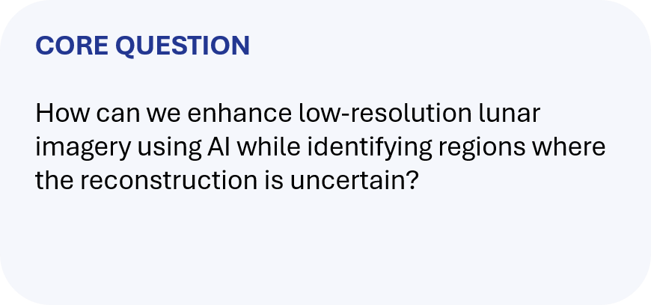
INNOHACK 2.0
Lunar images can lose important spatial detail because of limited resolution, sensing conditions and image degradation.
AI super-resolution can improve visual detail, but reconstructed details may not be directly supported by the original observation.
Researchers need to know where an enhanced feature is reliable and where it should be reviewed cautiously.
A scalable workflow should provide both the enhanced image and evidence about reconstruction reliability.

Slide 3


INNOHACK 2.0
TRUST-AWARE PLANETARY SUPER-RESOLUTION
Compare the reconstruction with the original observation and preserved terrain structures.
Generate a region-wise scientific confidence map showing high, medium and low support.
1
ENHANCE
2
3
AI super-resolution converts low-resolution lunar imagery into a higher-resolution representation.

Slide 4
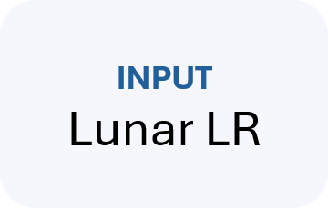
INNOHACK 2.0
PREPROCESS
Normalize
TILE
Large scenes
SR MODEL
4× AI
VERIFY
Consistency
CONFIDENCE
Evidence
OUTPUT
HR + report
Start from a proven super-resolution architecture and adapt it to lunar imagery.
Create realistic LR/HR training pairs using controlled degradation.
Use overlapping tiles and seamless stitching for large scenes
Consistency: compare the original observation with a re-projected/downsampled reconstruction.
Terrain: preserve crater rims, ridges, edges and other structural cues.
Confidence combines evidence; it does not claim pixels are simply 'real' or 'fake'.

Slide 5
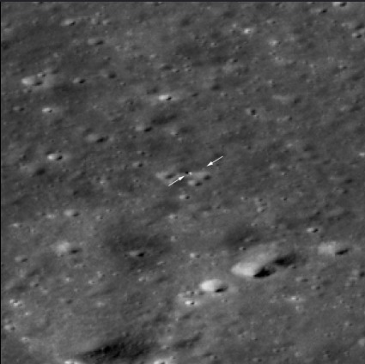
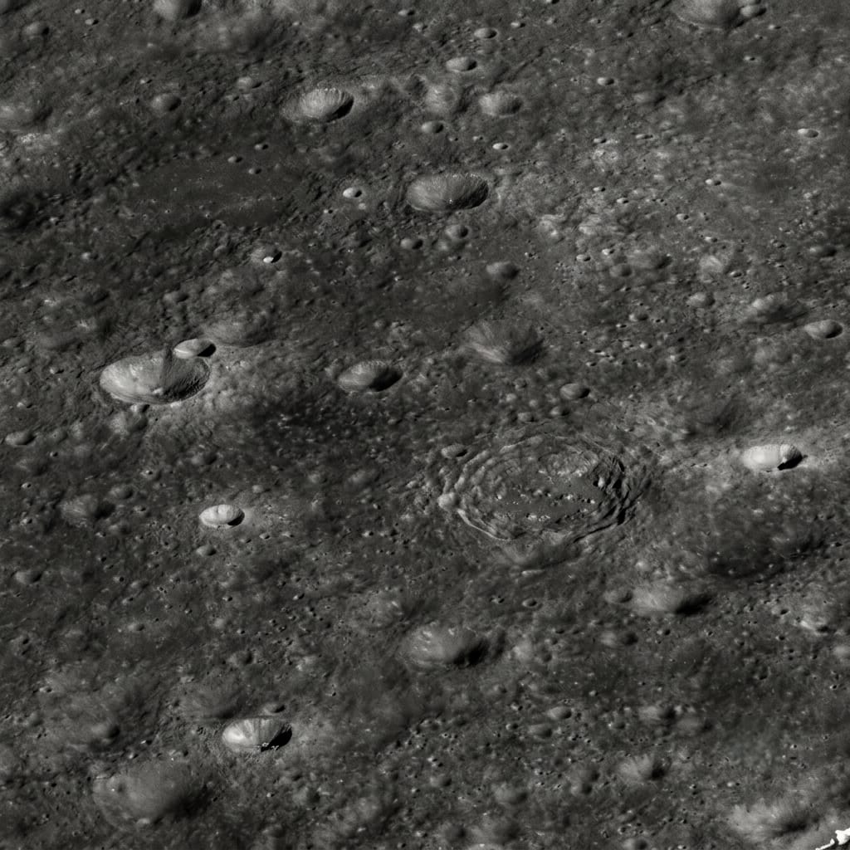
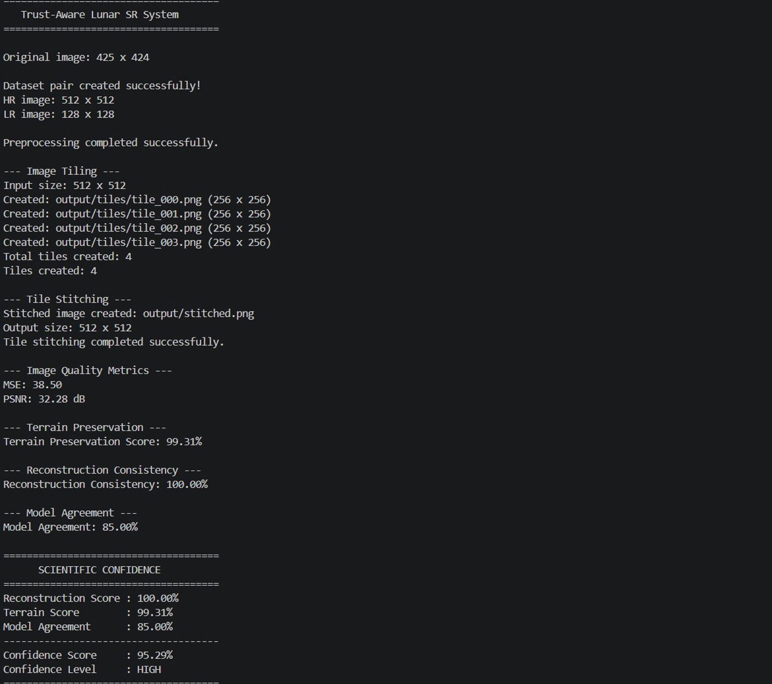
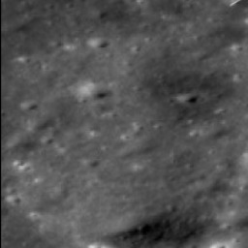
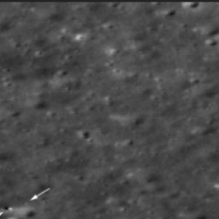

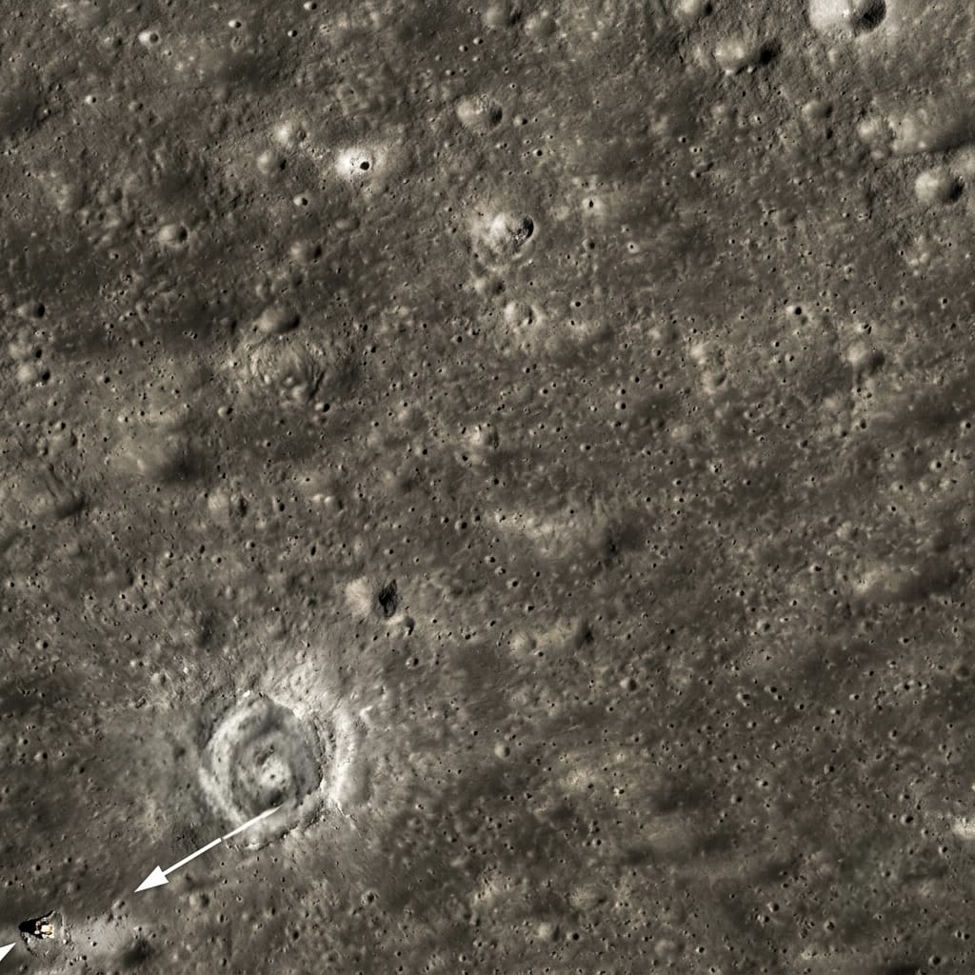
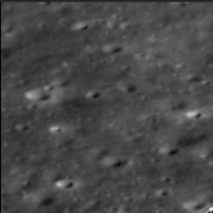
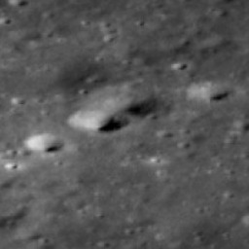
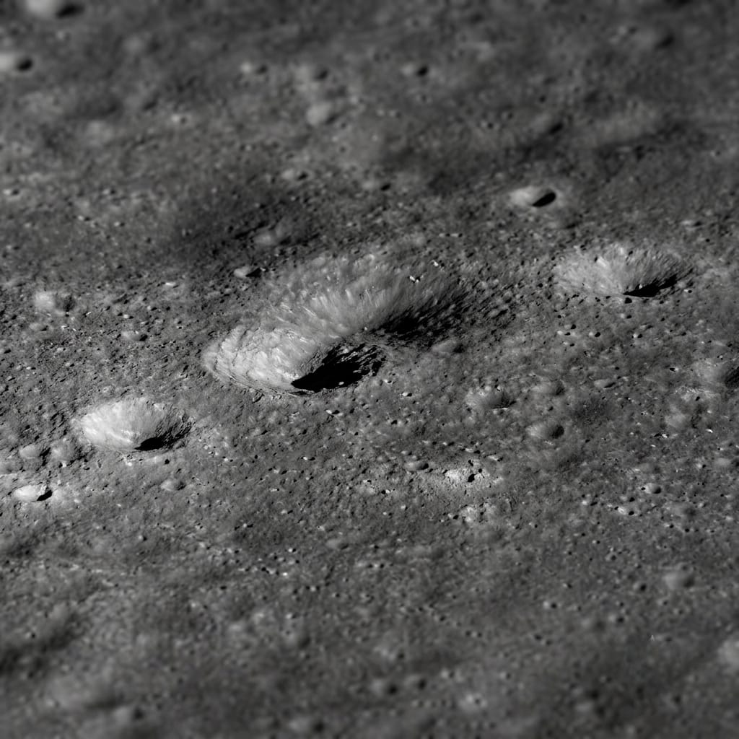
INNOHACK 2.0
ORIGINAL LOW-RES
AI-ENHANCED + CONFIDENCE

Slide 6
INNOHACK 2.0
IMPACT & USE CASES
WHO BENEFITS?
ISRO / planetary researchers / geology teams / remote-sensing researchers
Planetary scientists: inspect enhanced terrain with an explicit reliability layer.
Geological analysis: prioritize craters, ridges, boulders and other surface structures.
Mission / archival analysis: improve imagery usability without hiding uncertainty.
Research workflows: export enhanced imagery, metrics and confidence information together.
REAL-WORLD VALUE
Better visual detail + explicit caution zones for scientific review.
SCALING
Tile-based processing supports large planetary scenes and batch workloads.

Slide 7
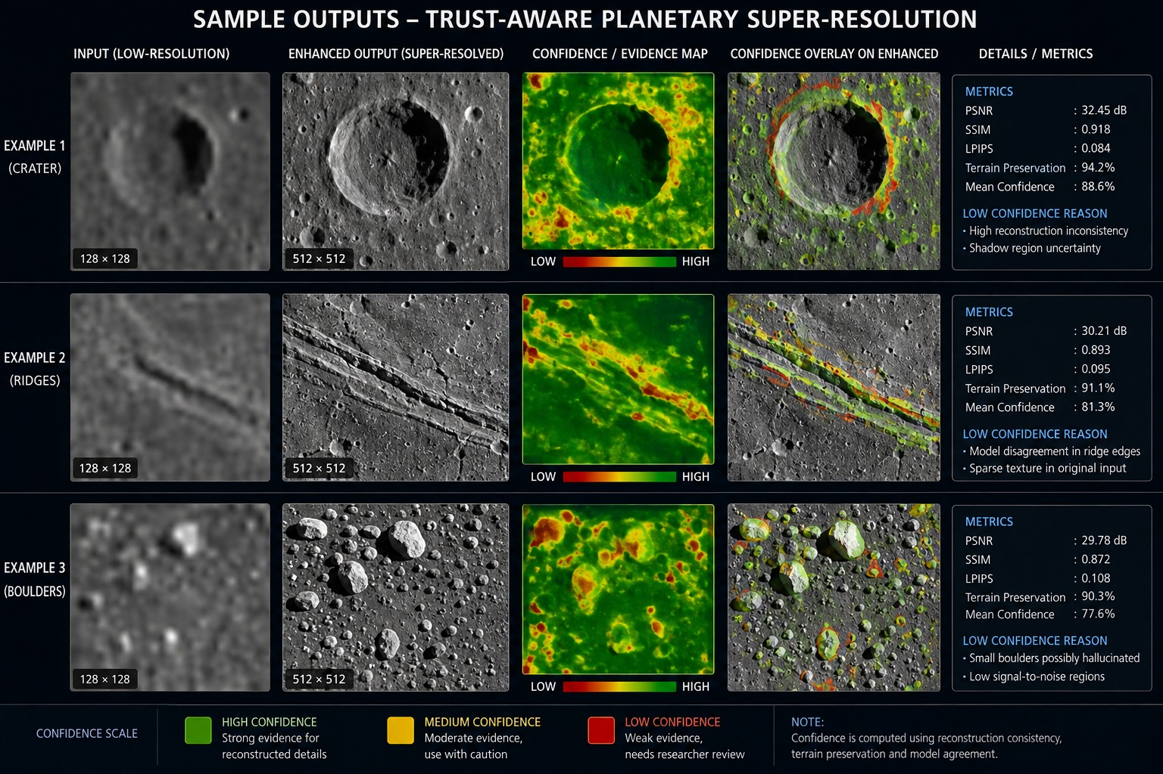
EXPECTED OUTPUTS

Slide 8
INNOHACK 2.0
CHALLENGES FACED
Obtaining consistent high-resolution references and realistic degradation pairs.
Avoiding visually pleasing but unsupported reconstructed structures.
Designing a confidence score that is useful rather than a generic error heatmap.
Processing very large images efficiently.
Use controlled degradation during training and validation.
Measure consistency against the original observation.
Combine reconstruction, terrain and model-agreement signals.
Use tiling and GPU-friendly inference for scalability.

Slide 9
INNOHACK 2.0
FUTURE SCOPE
Mission-specific degradation models for different spacecraft sensors.
Integration of multi-view observations for stronger geometric verification.
3D terrain / DEM-aware confidence estimation.
Automatic detection of scientifically interesting regions.
Support additional planetary missions and instruments.
PDS4-aware input/output and metadata preservation.
Human-in-the-loop review of low-confidence regions.
Cloud / GPU deployment for large-scale planetary archives.

Slide 10
INNOHACK 2.0
CONCLUSION
ENHANCE THE IMAGE — BUT ALSO SHOW HOW MUCH IT SHOULD BE TRUSTED.
AI super-resolution improves spatial detail.
Scientific verification checks reconstruction consistency and terrain preservation.
A confidence map exposes uncertain regions instead of hiding them.
NOVELTY
A trust layer around planetary super-resolution: region-wise evidence accompanies every enhanced image.

Slide 11
INNOHACK 2.0
ACKNOWLEDGEMENTS
We sincerely thank the hackathon organizers for providing us with the opportunity to work on the problem statement “Satellite Image Enhancement for Space Research.”**
We are grateful to our mentors, faculty members, and teammates for their continuous guidance, collaboration, and support throughout the development of our **Trust-Aware Lunar Super-Resolution System**.
We also acknowledge **ISRO and other space research organizations** for making lunar and planetary imagery publicly available for research and educational purposes. These datasets helped us understand real-world satellite imagery and develop our image preprocessing, super-resolution, scientific validation, and confidence-estimation pipeline.
We would also like to acknowledge the developers of the open-source libraries and tools used in our implementation, which greatly supported the development and testing of our prototype.
Finally, we thank our team mates and everyone who contributed ideas, technical support, testing, and feedback that helped us improve the project.

